Slide 1
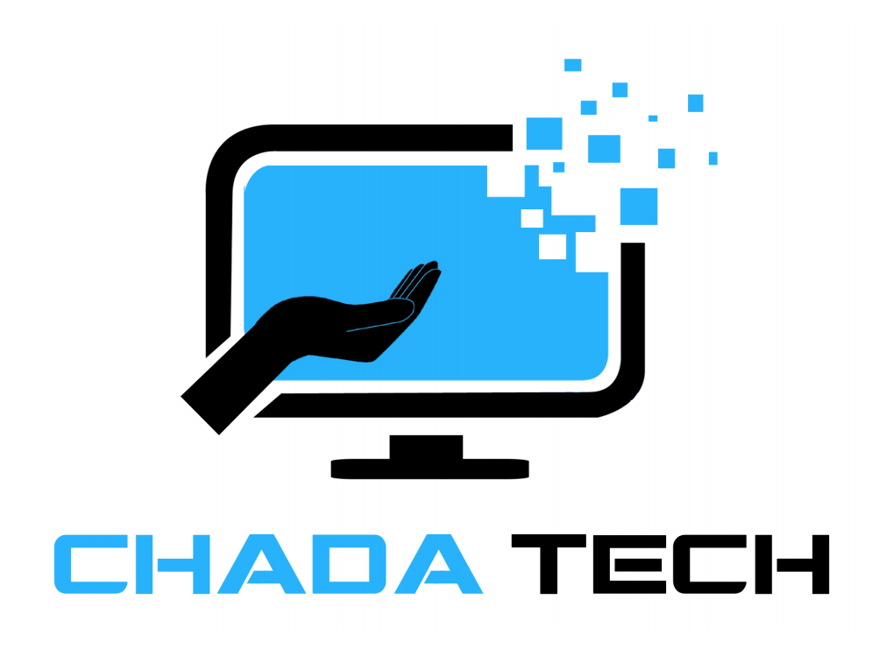
SNHU Travel Project
Agile vs Waterfall Development
ChadaTech Pilot Program

Slide 2
Agile Roles Explanation
Product Owner: Defines and prioritizes product backlog
Focuses on maximizing customer value
Scrum Master: Facilitates Scrum events and removes blockers
Ensures Agile practices are followed
Development Team: Developers and testers working together
Self-organized and cross-functional team

Slide 3
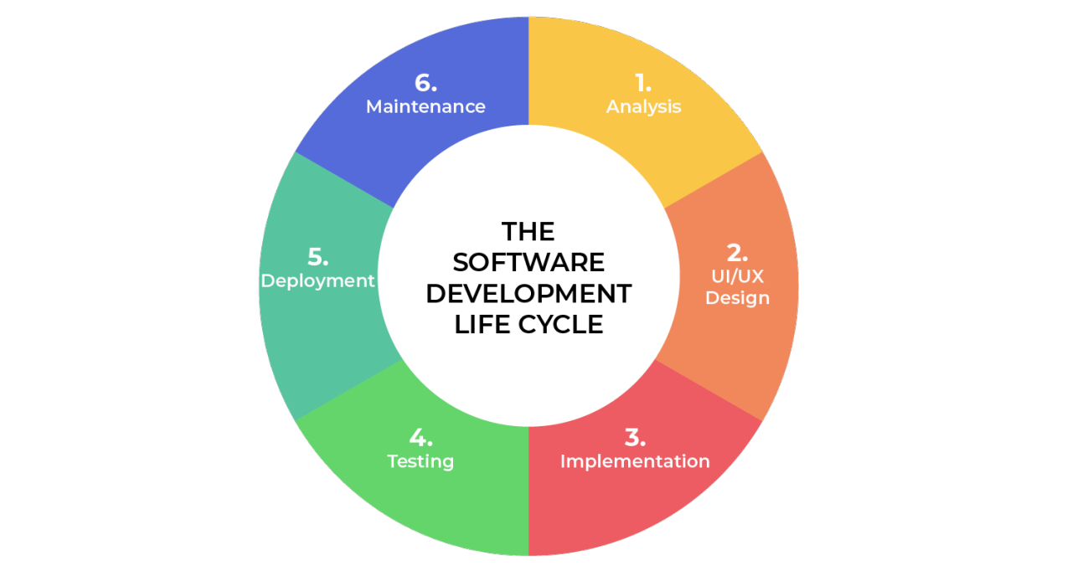
Software Development Life Cycle
1. Analysis
Gather requirements from stakeholders
Identify user needs
2. Design
Plan system structure and features
Consider time and budget
3. Implementation
Build features in small increments
4. Testing
Identify bugs and issues
5. Deployment
Release product to users
6. Maintenance
Fix bugs and add improvements

Slide 4
WATERFALL APPROACH
With a waterfall development approach, the process would be much more rigid and follow a set order compared to Agile. For the SNHU Travel project, all requirements would need to be clearly defined at the start before moving on to design and development. If the Product Owner wanted to shift the focus to detox and wellness travel later, it would cause major delays because earlier steps like requirements and design would have to be revisited or redone. This would likely increase both the time and cost of the project. Unlike Agile, where changes can be made by updating certain features, waterfall would mean going back through several stages. Because of this, the team would have less flexibility and would not be able to respond quickly to new ideas or market changes.

Slide 5
Agile Approach
When deciding between waterfall and Agile, it helps to look at how stable the requirements are, how complex the project is, and how often things might change. If the requirements are clear and unlikely to change, waterfall can be a good fit since everything is planned from the start. But if the project is more complicated and changes are likely, Agile usually works better. In my experience with the SNHU Travel project, Agile was more effective because our requirements changed when we shifted our focus to detox and wellness travel. Instead of starting over, we just adjusted certain features and kept moving forward. This experience showed me that Agile is best for projects that need flexibility, teamwork, and ongoing improvement, while waterfall works better when things are predictable and stable.

Slide 6
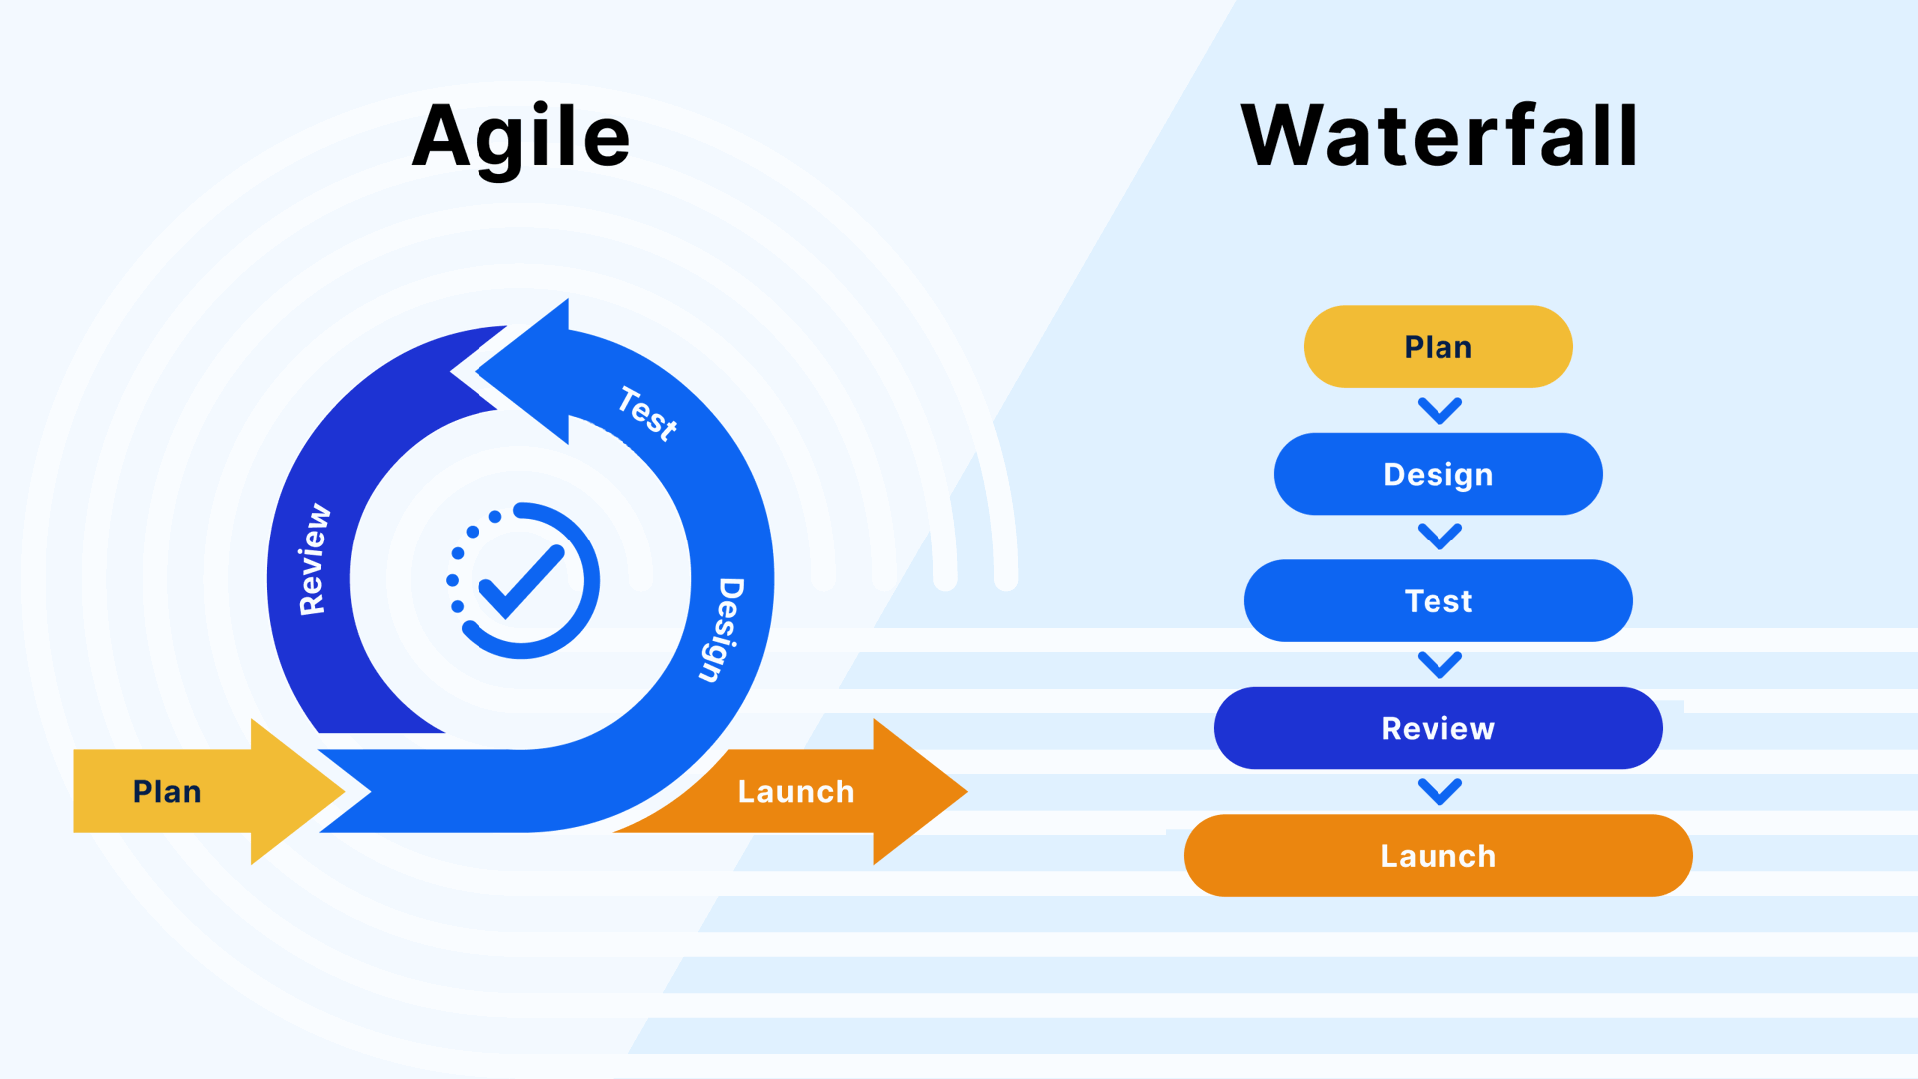
Waterfall vs Agile
Waterfall
Fixed sequence of steps
Hard to make changes
Requires full planning upfront
Agile
Flexible and adaptive
Continuous development cycles
Faster response to change

Slide 7
Why Agile Was Better
Agile was a better approach for the SNHU Travel project because it allowed the team to adapt quickly to changing requirements without slowing down development. When the Product Owner shifted the focus to detox and wellness travel, the team did not have to restart the entire project. Instead, only specific parts of the system, like the slideshow content, were updated. This flexibility saved time and reduced unnecessary rework. Agile also improved communication between team members through continuous feedback and collaboration, which helped ensure everyone stayed aligned. Overall, Agile made it easier to deliver a working product efficiently while still responding to changes and user needs.

Slide 8
Final Decision
Agile was the best approach for this project
Allowed quick adjustments when requirements changed
Kept project on schedule
Waterfall better only for fixed and predictable projects

Slide 9
References (APA 7th Edition)
Schwaber, K., & Sutherland, J. (2020). The Scrum guide: The definitive guide to Scrum: The rules of the game. Scrum.org. https://scrumguides.org
Atlassian. (2023). What is Jira? https://www.atlassian.com/software/jira
Beck, K., et al. (2021). Manifesto for Agile software development. Agile Alliance. https://agilemanifesto.org
Atlassian. (2024). Waterfall methodology. https://www.atlassian.com/agile/project-management/waterfall-methodology

